Slide 1









However
The
man
writes
Rhythm
on
the
blackboard.
Second
…
Harmony
on
…
Emm
Wait
…
Certain
Not Sure
Update
Policy Model
Policy Grad. Optimization
LLM Decoder
Only Keep Key Tokens’ Loss
Vision Encoder
A₁
A₂
…
A_{G}
"The video introduces 10 principles of design. Which principle is introduced last in the video?"
Loss Computation
R₁
R₂
…
R_{G}
Completion Generating & Token Importance Analysis
Uncertainty-Aware – Entropy Analysis
Vision-Aware Counterfactual Reasoning
Entropy Calculation
Logits Shift Calculation
MASKED
Let me think … The video introduces ... Let‘s go through them … First, the
man writes Rhythm on the blackboard… The last principle is Harmony.
"The video introduces 10 principles of design. Which principle is introduced last in the video?"
Temporal-Aware Counterfactual Reasoning
High Entropy – Uncertain Tokens
Low Entropy – Certain Tokens
Logits Shift Calculation
Shuffled Frames
Let me think … The video introduces ... Let‘s go through them … First, the
man writes Rhythm on the blackboard… The last principle is Harmony.
"The video introduces 10 principles of design. Which principle is introduced last in the video?"
the smallest logits shift
the largest logits shift

Slide 2


Update
Policy Model
Policy Grad. Optimization
LLM Decoder
Only Keep Key Tokens’ Loss
Vision Encoder
A₁
A₂
…
A_{G}
"The video introduces 10 principles of design. Which principle is introduced last in the video?"
Loss Computation
R₁
R₂
…
R_{G}
Completion Generating & Token Importance Analysis
Vision-Aware Counterfactual Reasoning
Uncertainty-Aware – Entropy Analysis
Logits Shift Calculation
Entropy Calculation
MASKED
Let me think … The video introduces ... Let‘s go through them … First, the
man writes Rhythm on the blackboard… The last principle is Harmony.
"The video introduces 10 principles of design. Which principle is introduced last in the video?"
High Entropy – Uncertain Tokens
Low Entropy – Certain Tokens
Temporal-Aware Counterfactual Reasoning
Final Selected Tokens
Logits Shift Calculation
Let me think … The video introduces ... Let‘s go through them … First, the
man writes Rhythm on the blackboard… The last principle is Harmony.
Shuffled Frames
"The video introduces 10 principles of design. Which principle is introduced last in the video?"
the smallest logits shift
the largest logits shift

Slide 3
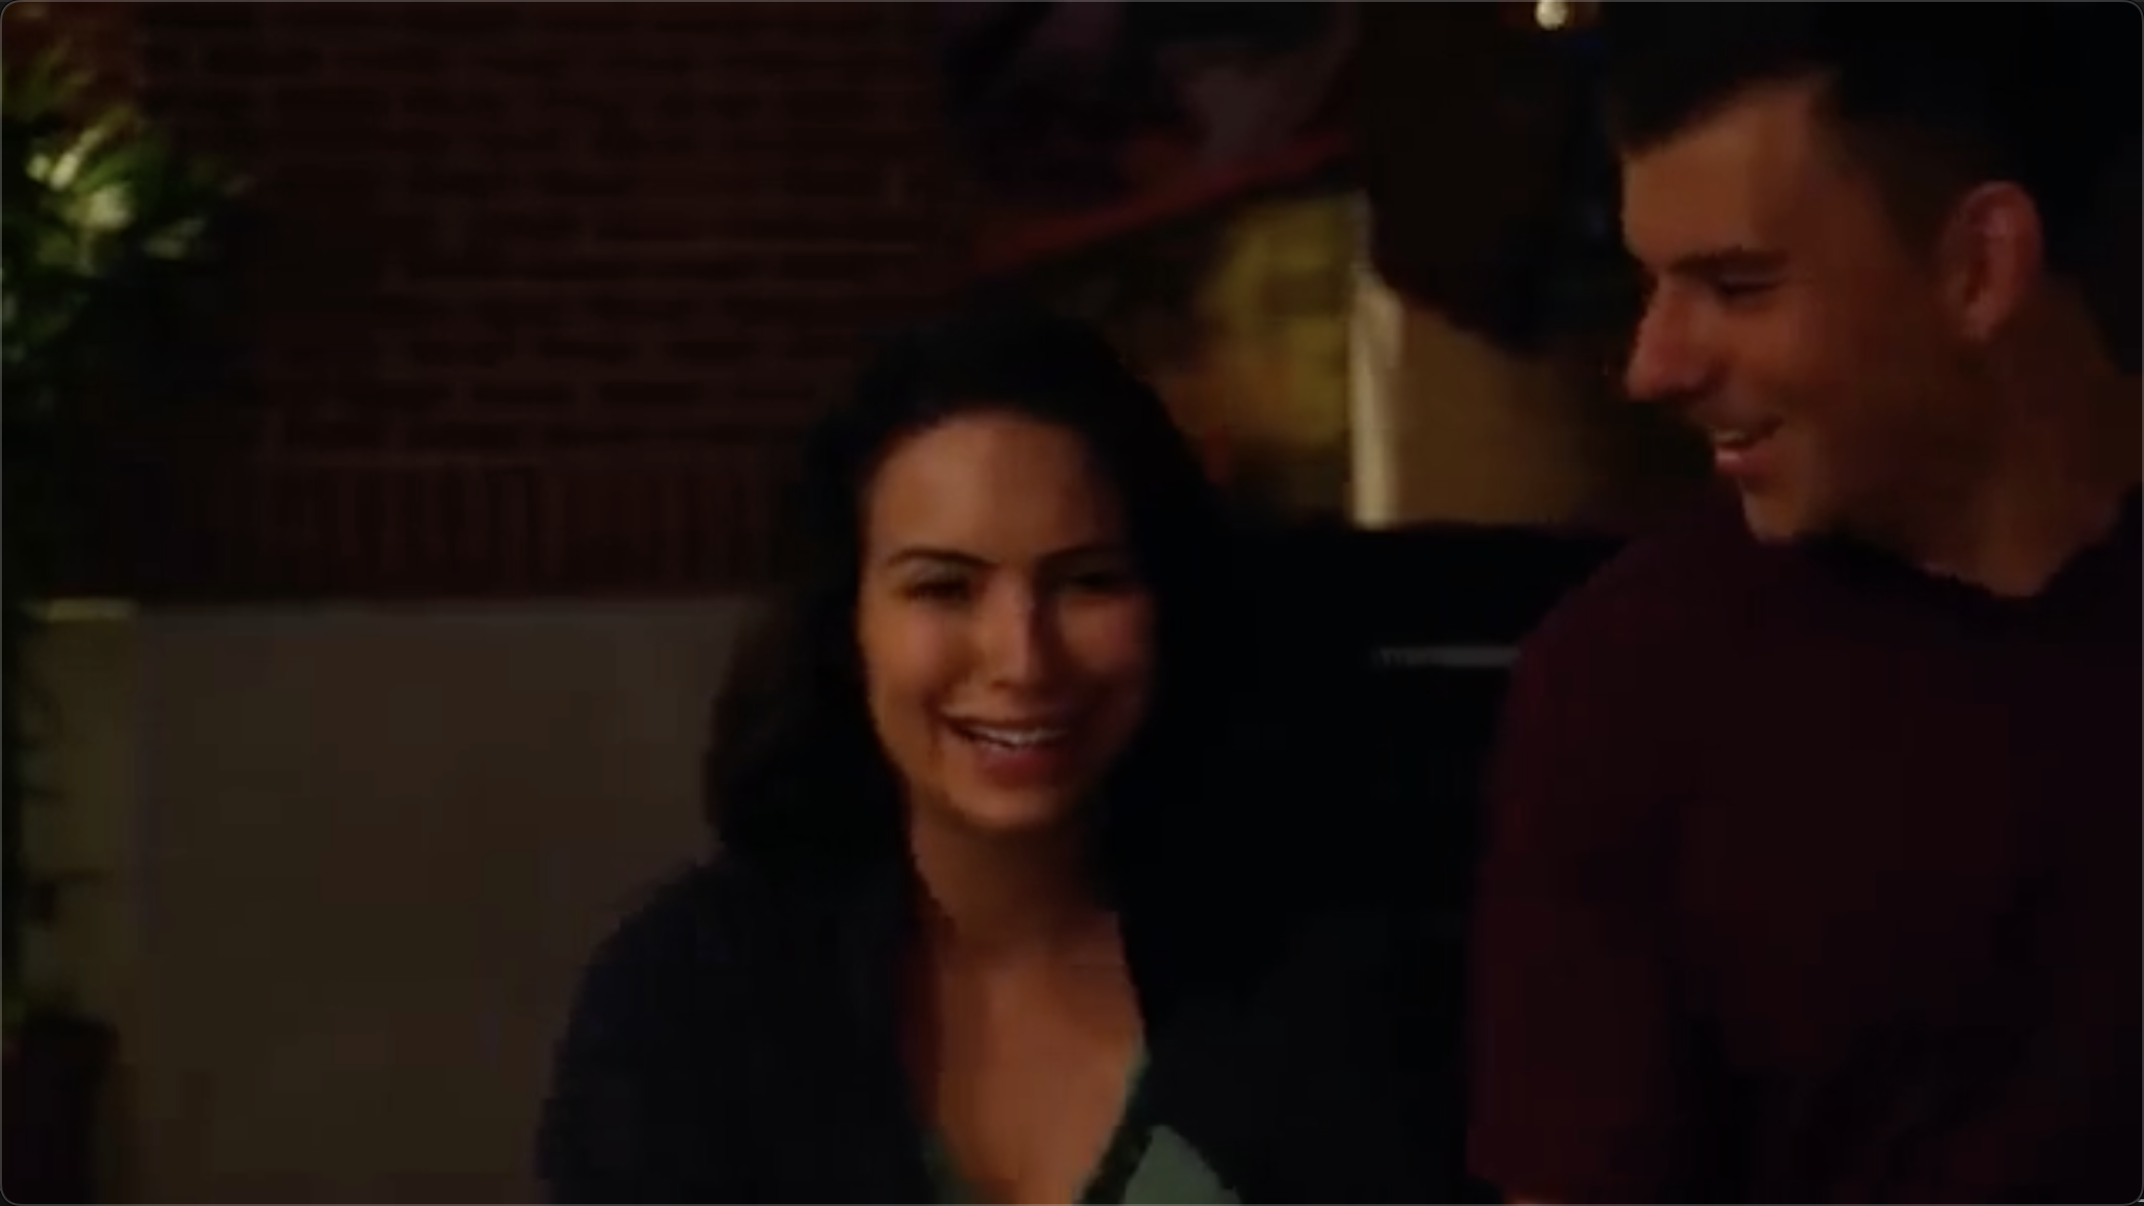
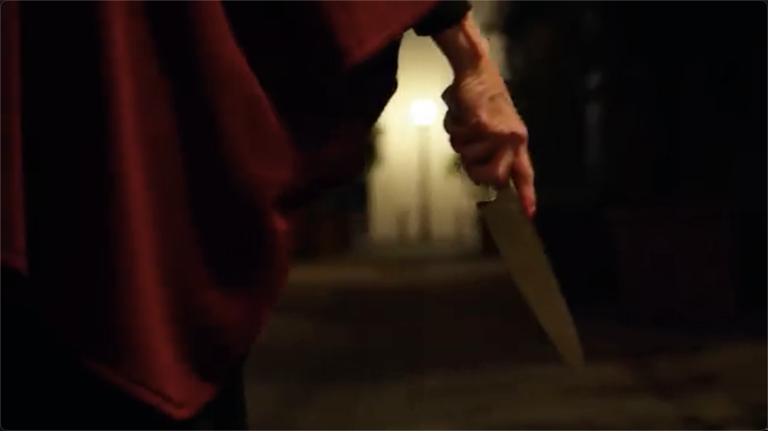
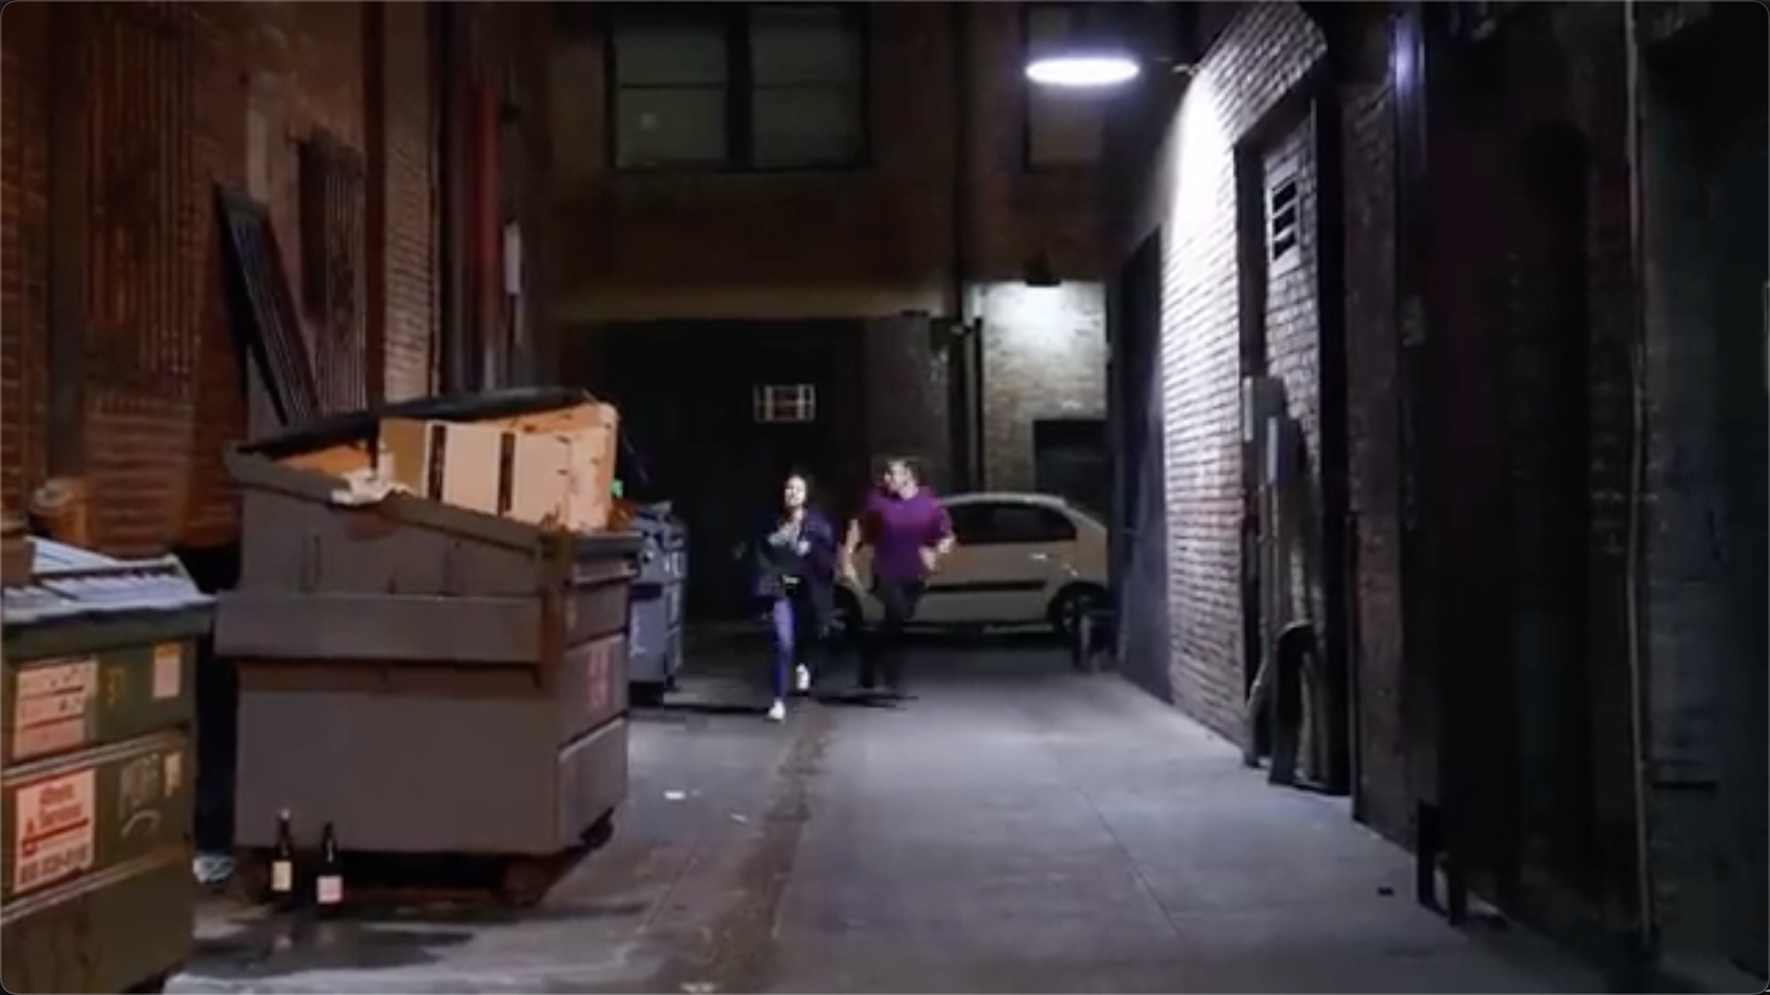
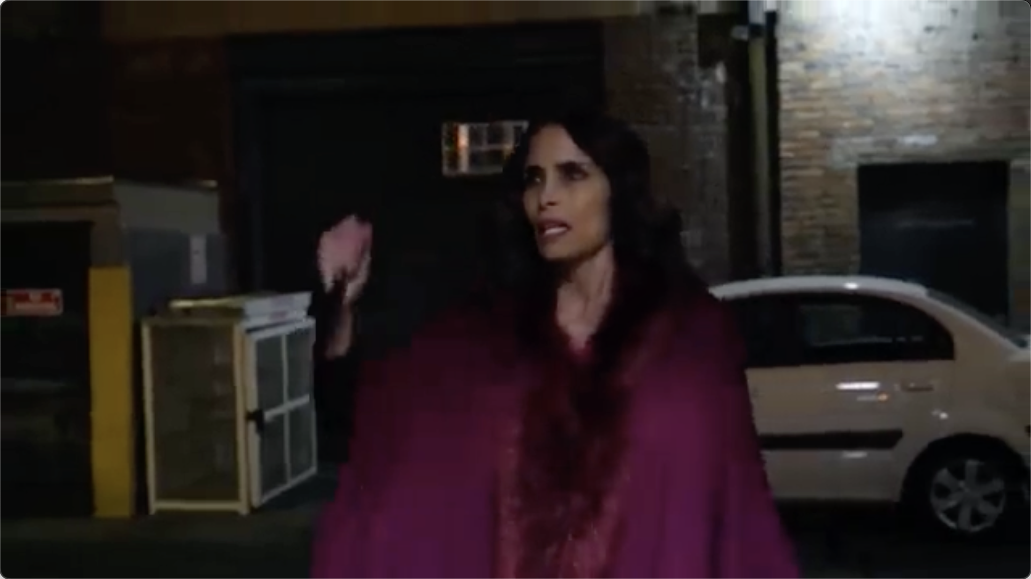
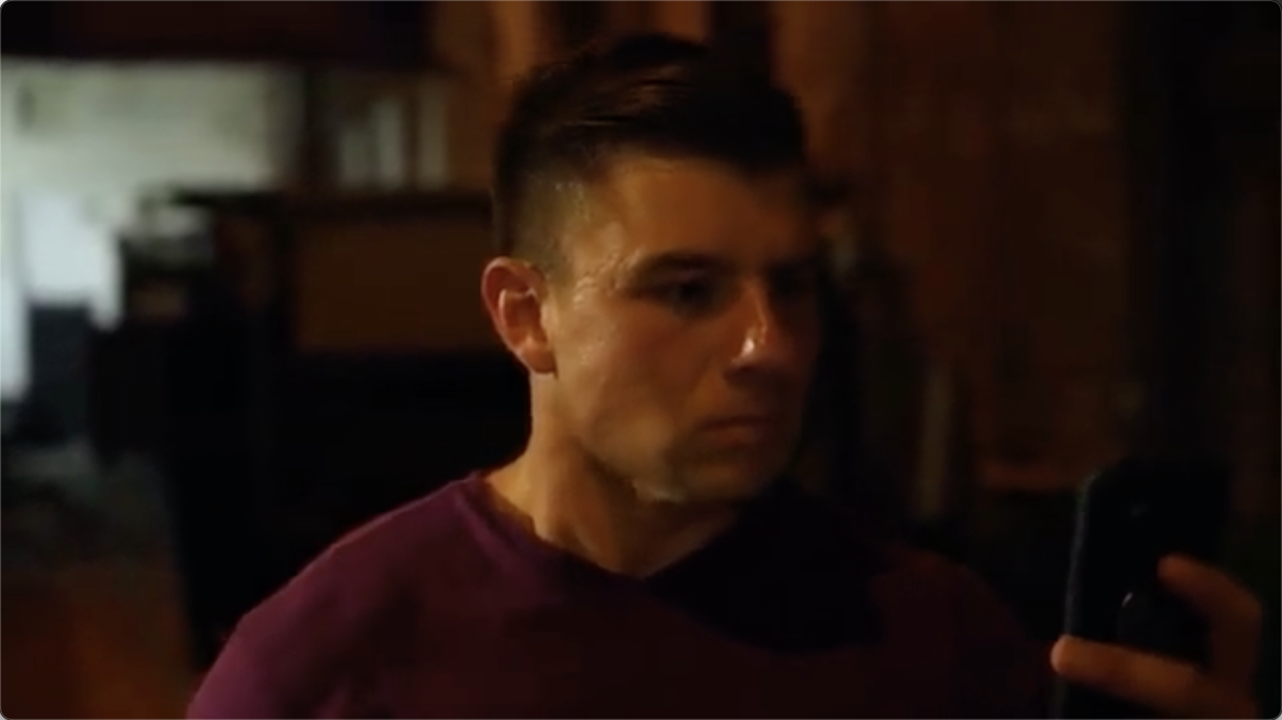
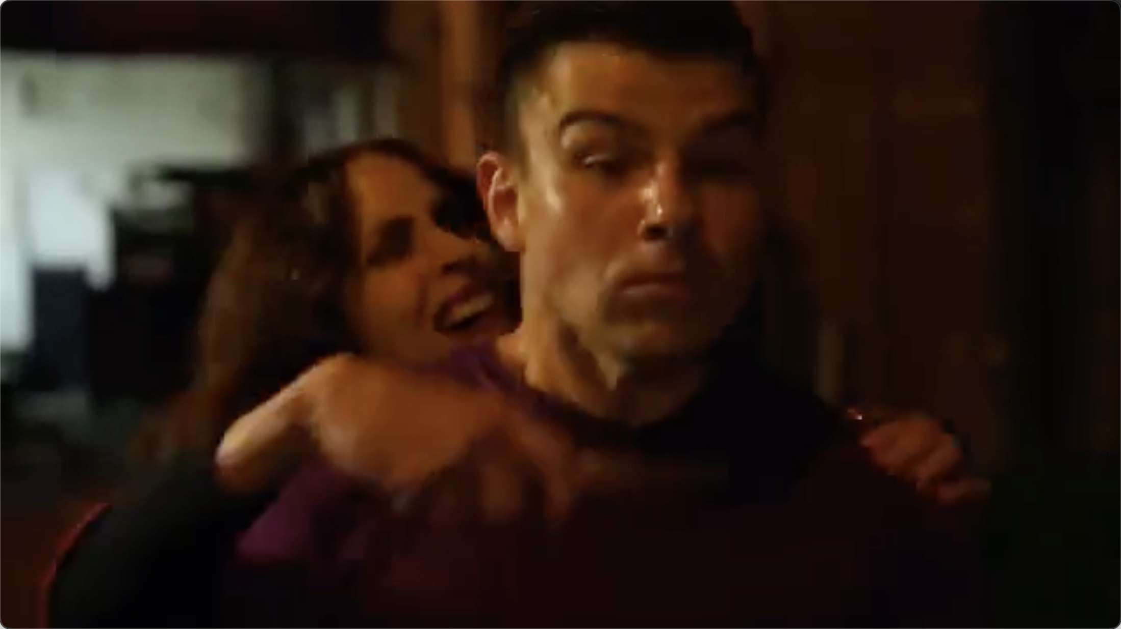
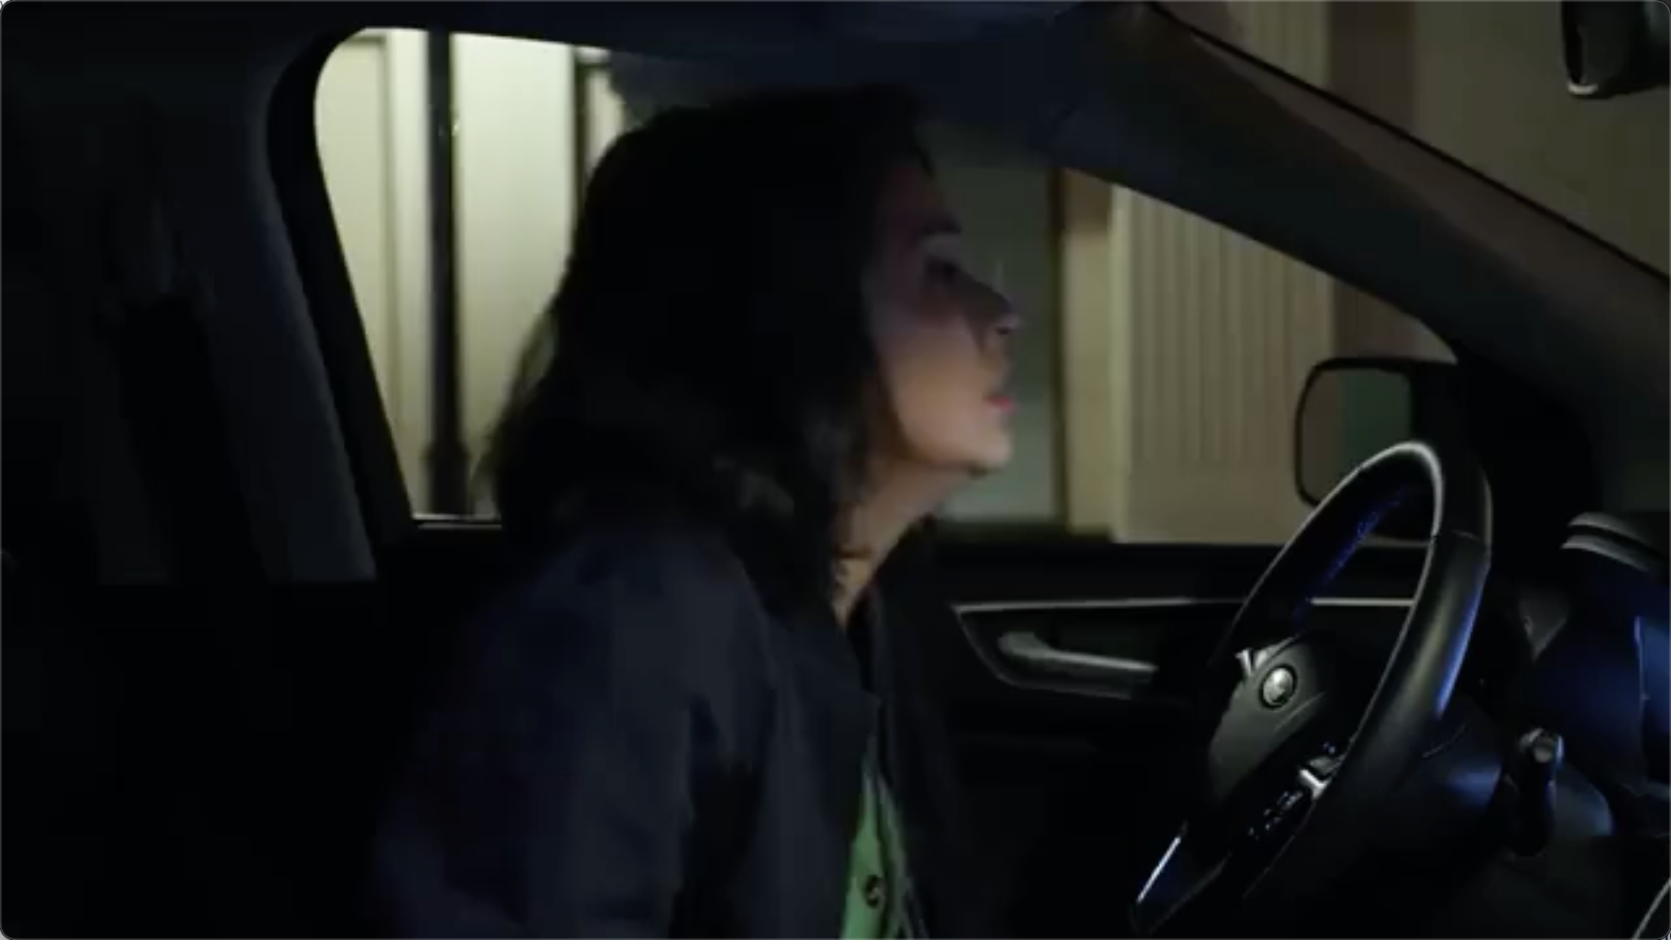
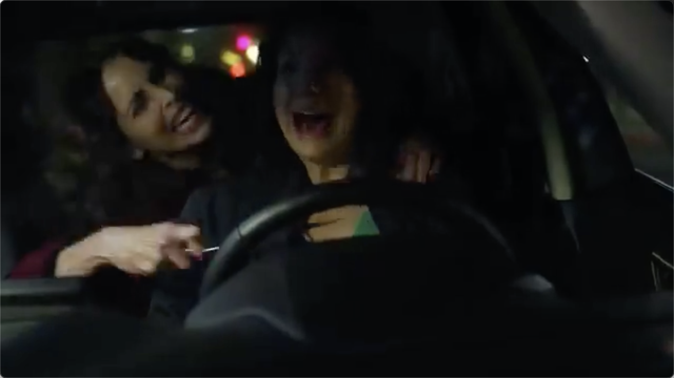
What is the core supernatural rule demonstrated by the long-haired woman?
Official Answer:
It can instantly appear in enclosed spaces (such as inside a car) and pursue regardless of terrain, proving that it possesses the ability to penetrate space. The correct answer is B: Ignore the limitations of space physics
T-GRPO
<think>Let's analyze the video step by step to determine the core supernatural rule demonstrated by the long-haired woman…….
3. **Transformation and Disguise**: The woman is seen in different outfits and settings, which could indicate that she has the ability to transform and disguise herself. This is a common supernatural ability in many stories, where characters can change their appearance or form.
4. **Unlimited Stamina Pursuit**: The woman is seen running through the alley and the street, which suggests that she has unlimited stamina. This is a supernatural ability that allows her to run for extended periods without getting tired. ......
6. **Control Electronic Devices**: The woman is seen using a phone, which could indicate that she has the ability to control electronic devices. However, this is not the core supernatural rule demonstrated by her.
7. **Ignore the Limitations of Space Physics**: The woman is seen running through the alley and the street, which suggests that she has the ability to ignore the limitations of space physics. However, this is not the core supernatural rule demonstrated by her.
Based on the analysis, the core supernatural rule demonstrated by the long-haired woman is her ability to transform and disguise herself.
Based on the analysis, the core supernatural rule demonstrated by the long-haired woman is her ability to transform and disguise herself. ……</think>\n<answer>E</answer>
Video-KTR(ours)
<think> Let's analyze the video step by step to determine the core supernatural rule demonstrated by the long-haired woman…….
2. **Disappearance and Reappearance**: The woman disappears and reappears in different locations, which implies that she can ignore the limitations of space physics. This is a significant supernatural ability as it allows her to move freely and unpredictably.
3. **Chasing Scene**: The woman is seen chasing the man through various urban environments, including alleyways and streets. This further emphasizes her ability to move quickly and unpredictably, which is not possible for a normal human…….
7. **Predict Future Actions**: There is no evidence in the video that the woman can predict future actions.
8. **Unlimited Stamina Pursuit**: While the woman is seen chasing the man, there is no indication that she has unlimited stamina.
Based on the analysis, the core supernatural rule demonstrated by the long-haired woman is her ability to ignore the limitations of space physics…….</think>\n<answer>B</answer>

Slide 4

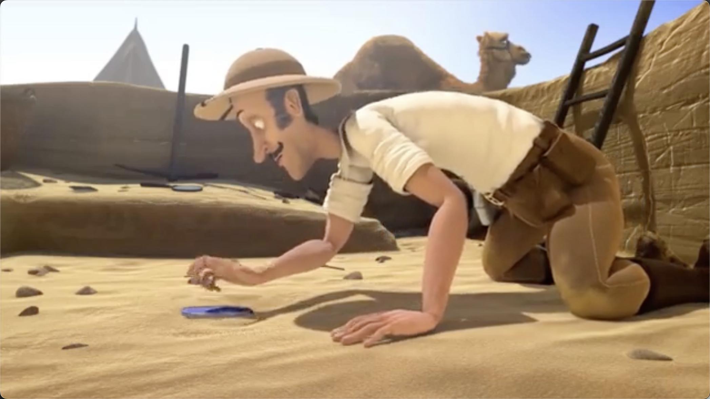
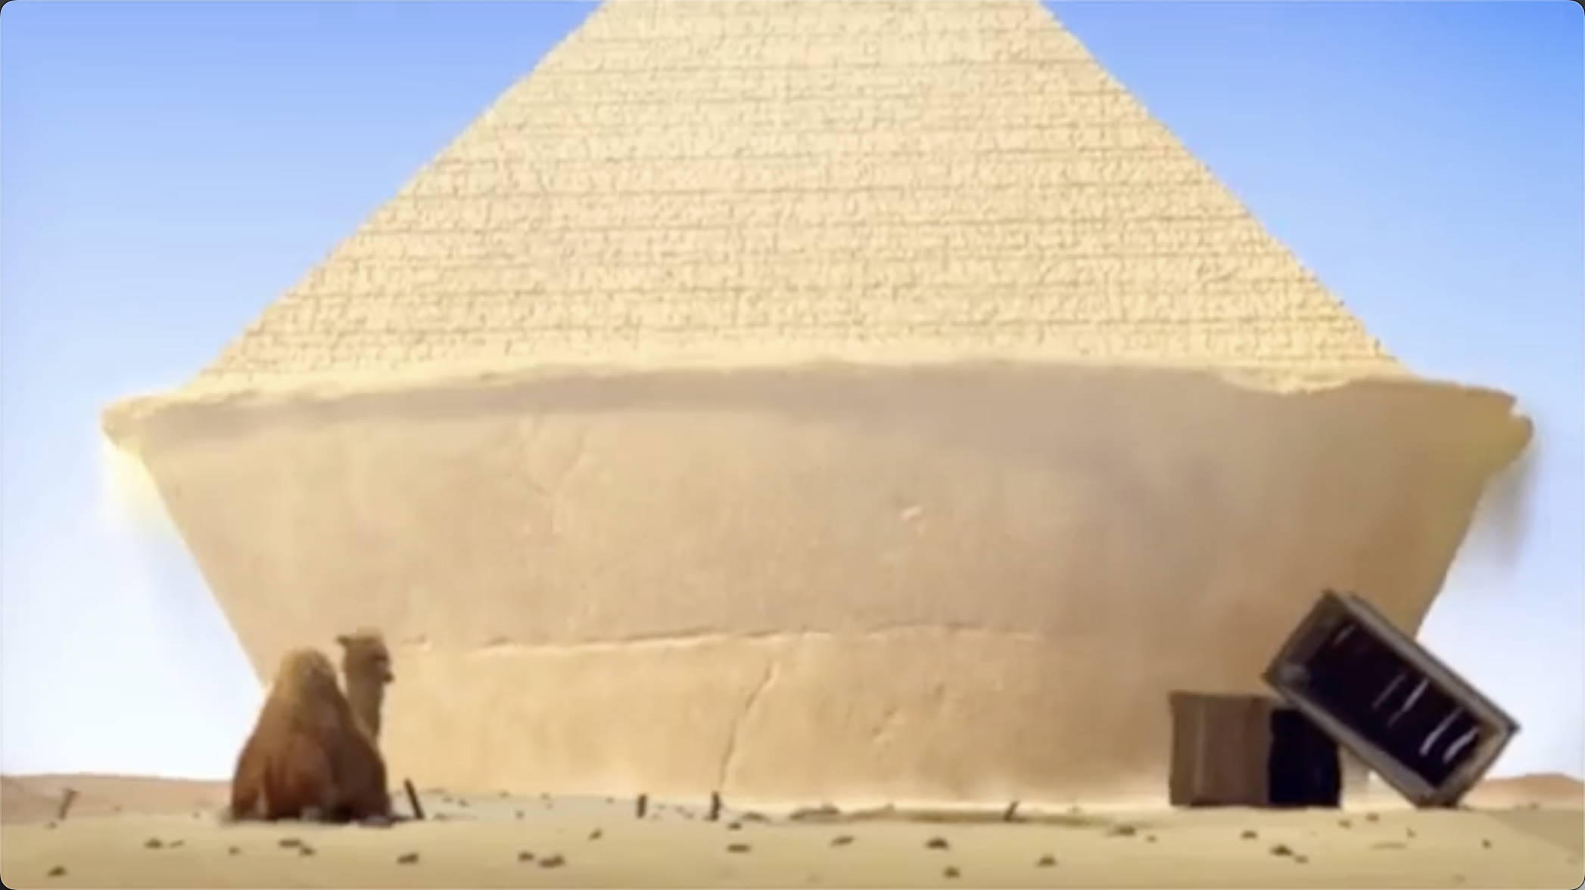
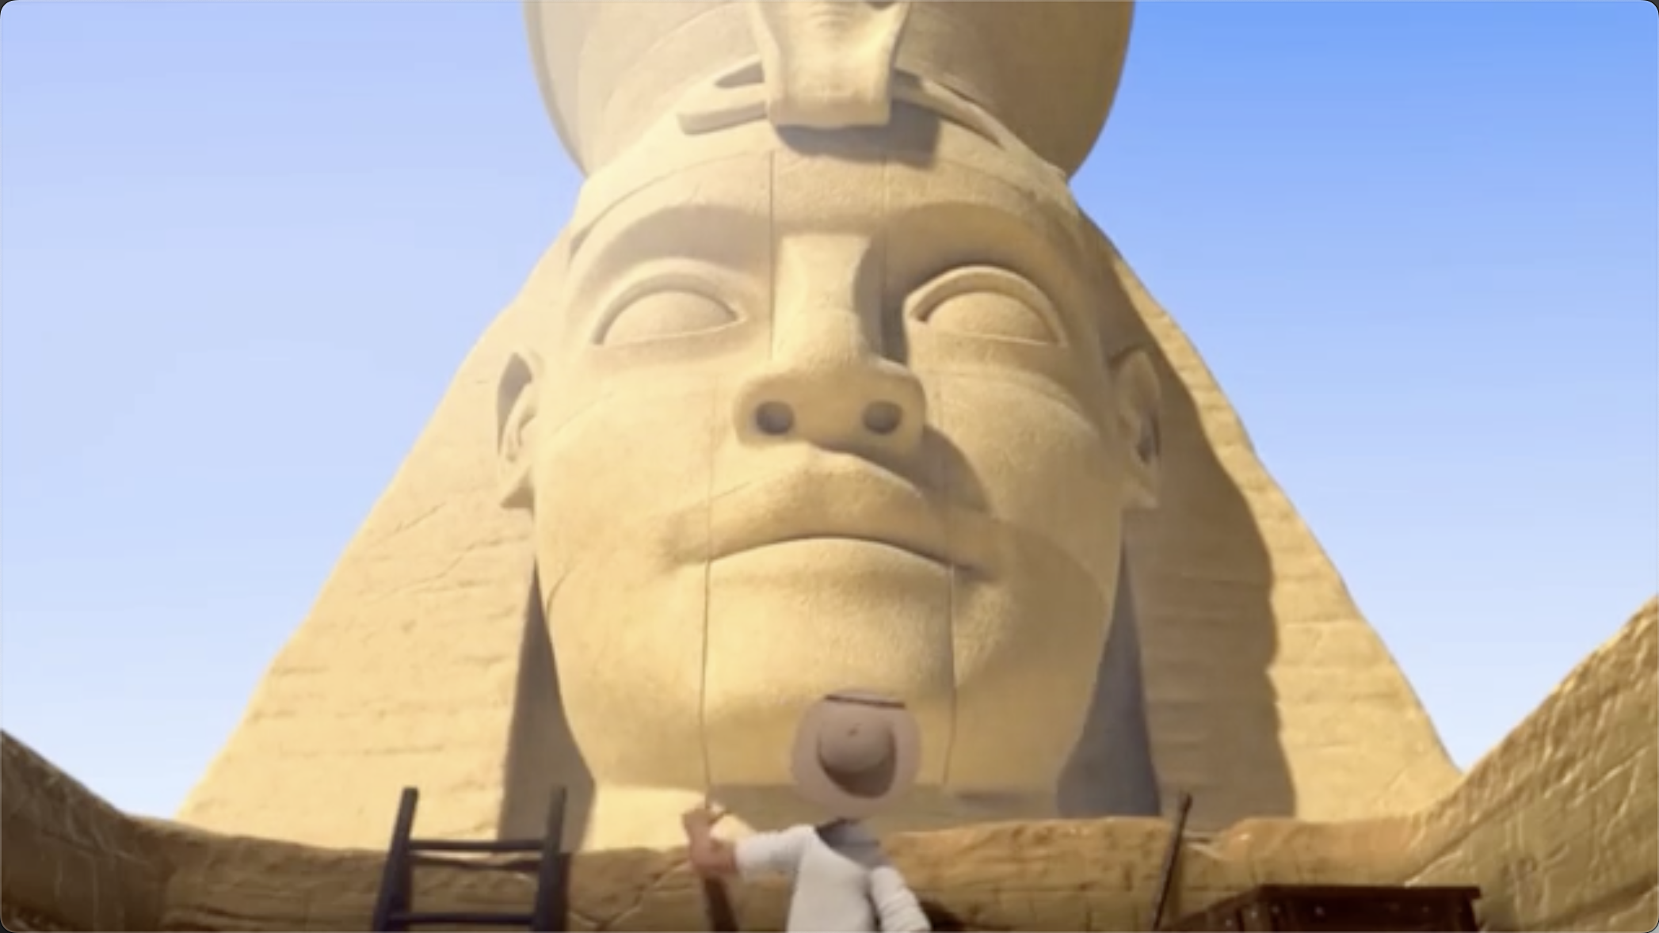
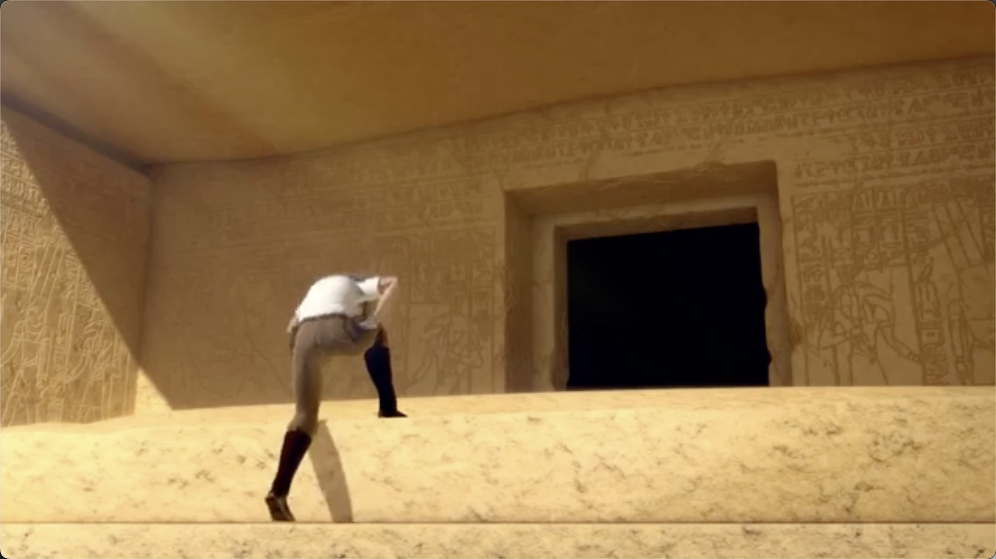
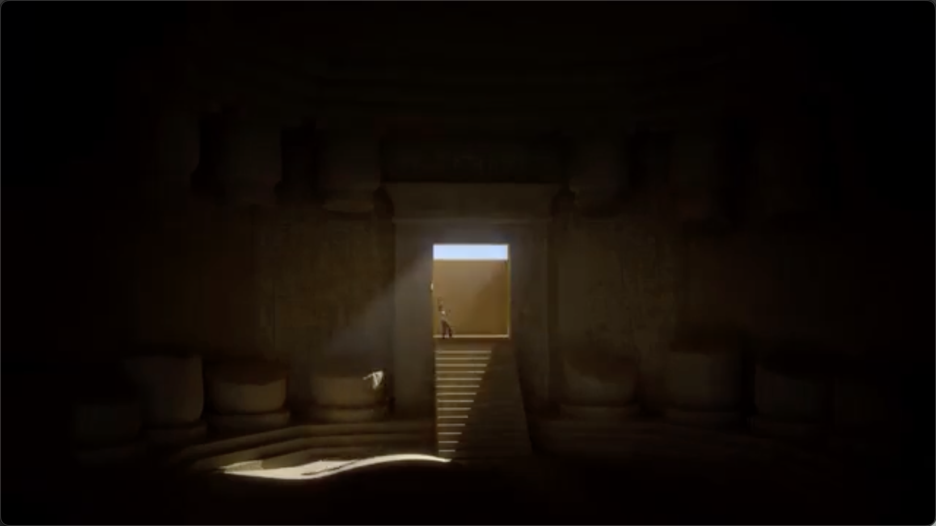

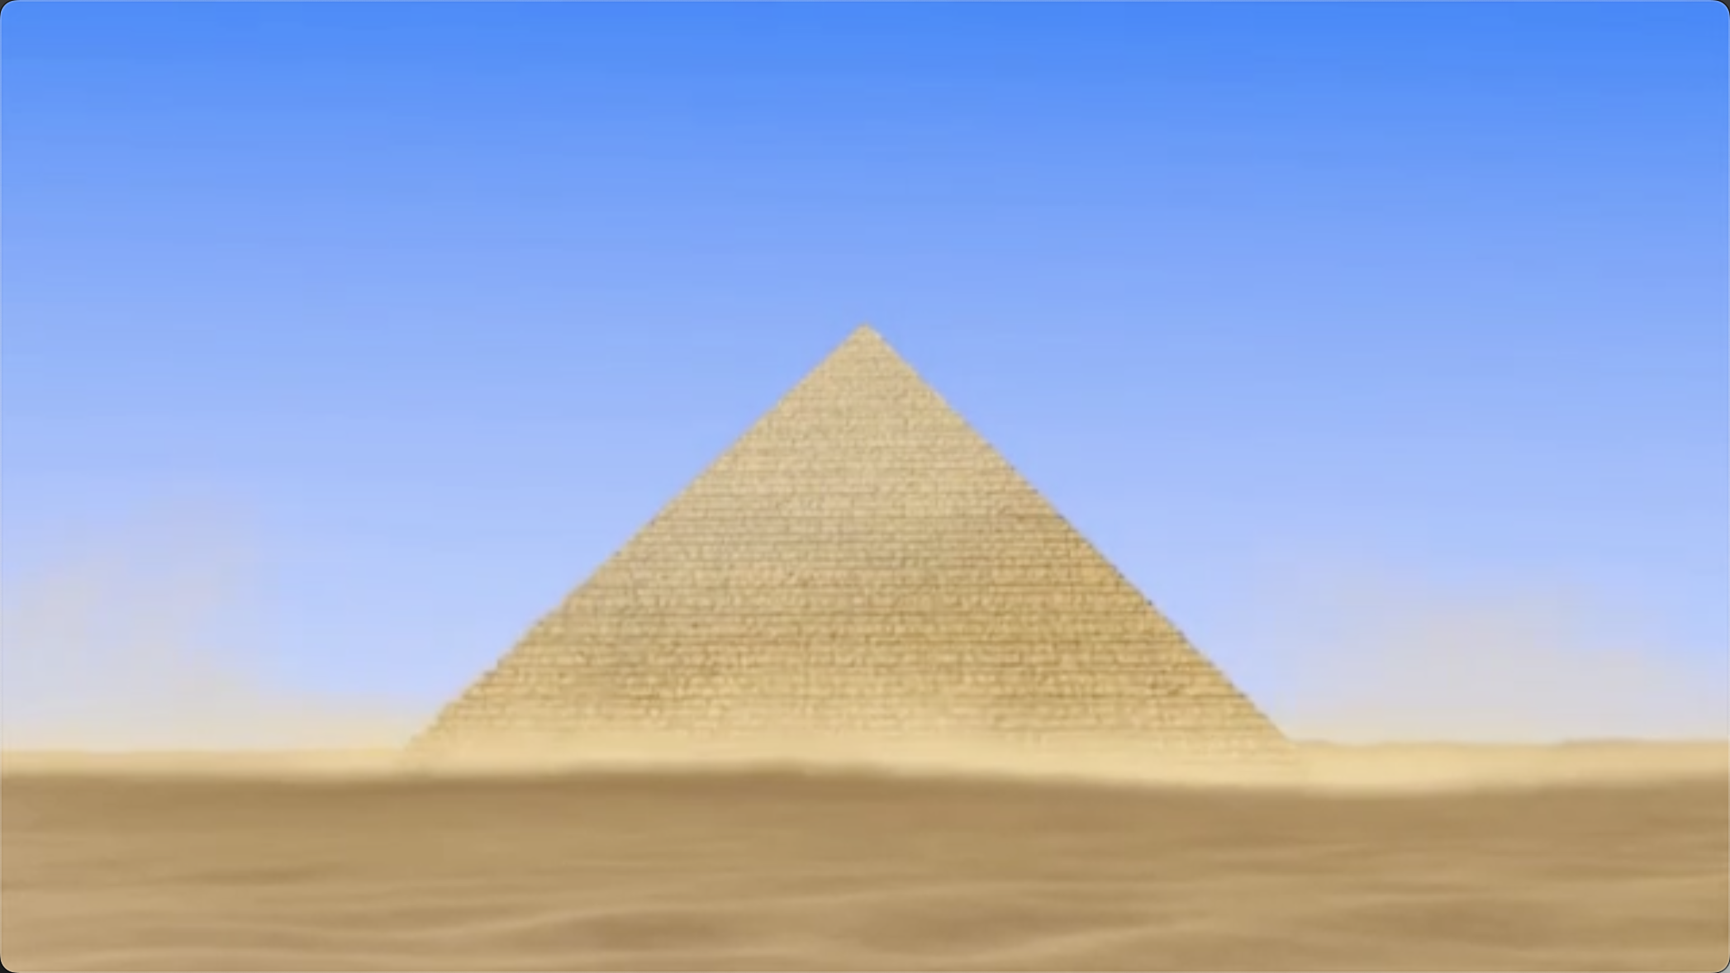
Original Completion Tokens
"Question": ""Which of the following events are arranged in the correct chronological order?
① The camel chews the token. ② The pyramid rises. ③ The tomb raider discovers the token. ④ The door suddenly closes. ⑤ The pyramid returns to its original state."
Video-KTR (ours)
Let's break down the sequence of events as they are presented in the video:
1. The tomb raider discovers the token. This is the first event that occurs, as the token is found in the sand.
2. The pyramid rises. This event follows the discovery of the token, as the pyramid is shown to be partially buried and then rises.
3. The camel chews the token. This event happens after the pyramid rises, as the camel is shown chewing on the token.
4. The door suddenly closes. This event occurs after the camel chews the token, as the door is shown closing.
5. The pyramid returns to its original state. This event happens after the door closes, as the pyramid is shown returning to its original state.
So, the correct chronological order of events is: ③②①④⑤.",
Let's analyze the video step by step to determine the core supernatural rule demonstrated by the long-haired woman.
1. **Initial Interaction**: The long-haired woman is seen walking with a man and then suddenly disappears, leaving him confused and concerned. This suggests that she has some form of supernatural ability that allows her to disappear or move in ways that defy normal human capabilities.
2. **Disappearance and Reappearance**: The woman disappears and reappears in different locations, which implies that she can ignore the limitations of space physics. This is a significant supernatural ability as it allows her to move freely and unpredictably.
3. **Chasing Scene**: The woman is seen chasing the man through various urban environments, including alleyways and streets. This further emphasizes her ability to move quickly and unpredictably, which is not possible for a normal human.
4. **Transformation and Disguise**: The woman changes her appearance and clothing, which could be interpreted as a form of transformation or disguise ability. However, this is not the core supernatural rule demonstrated in the video.
5. **Control of Electronic Devices**: There is no evidence in the video that the woman has the ability to control electronic devices.
6. **Mental Control Ability**: While the woman's actions might be influenced by her mental state, the core supernatural rule demonstrated is her ability to move and disappear in ways that defy normal human capabilities.
7. **Predict Future Actions**: There is no evidence in the video that the woman can predict future actions.
8. **Unlimited Stamina Pursuit**: While the woman is seen chasing the man, there is no indication that she has unlimited stamina.
Based on the analysis, the core supernatural rule demonstrated by the long-haired woman is her ability to ignore the limitations of space physics.

Slide 5

Policy Model
Update
LLM Decoder
Policy Grad. Optimization
"The video introduces 10 principles of design. Which principle is introduced last in the video?"
Vision Encoder
Only Keep Key Tokens’ Loss
A₁
A₂
…
A_{G}
Loss Computation
Token Importance Analysis
R₁
R₂
…
R_{G}
Uncertainty-Aware – Entropy Analysis
For Rent
Entropy Calculation
Token Selection
High Entropy – Uncertain Tokens
Low Entropy – Certain Tokens
Selected Tokens
Vision-Aware Counterfactual Reasoning
Original Completion Tokens
MASKED
"The video introduces 10 principles of design. Which principle is introduced last in the video?"
Logits Shift Calculation: Visual-Aware Tokens; Exclude Tokens
Dropped tokens
Temporal-Aware Counterfactual Reasoning
Original Completion Tokens
Shuffled Frames
"The video introduces 10 principles of design. Which principle is introduced last in the video?"
Logits Shift Calculation: Temporal-Aware Tokens; Exclude Tokens

